Slide 1

ALGOPILOT
(algorithm visualizer and execution platform)
By
Ikra Sayyad(23206006)
Pratiksha Pathak(22106127)
Disha Waghmare(22106033)
Shikshita Yadav(22106092)
Project Guide
Dr. Jaya Gupta

Slide 2
Outline
Introduction
Literature Survey of the existing systems
Limitations of the existing systems
Problem statement and Objective
Proposed System
Experimental Setup
Implementation
Conclusion
References
Research Paper Publication / Patent/ Copyright status

Slide 3
INTRODUCTION
Mobile Access: Provides offline functionality and a simple, intuitive interface for all learners.
Interactive Features: Supports adjustable animation speed, step navigation, and clear visual explanations.
Scalable & Adaptable: Modular design allows adding new algorithms to meet evolving academic needs.
Engaging Learning: Shifts DSA education from passive lectures to interactive, student-centered visualization.
Empowering Students: Builds problem-solving confidence, curiosity, and long-term understanding through exploration.

Slide 4
MOTIVATION
Overcome challenges of traditional, passive DSA teaching methods.
Improve student understanding of complex algorithmic concepts.
Enhance accessibility for learners without internet or high-end devices.
Increase engagement and interactivity to boost motivation and problem-solving skills.
Provide scalable, adaptable tools that support diverse learning needs and environments.

Slide 5
OBJECTIVES
Interactive & Mobile-Friendly – Step-by-step algorithm visualization for self-paced learning anytime, anywhere
Bridge Theory & Practice – Real-time simulations to build deeper conceptual understanding
Scalable & Modular – Easily expand with new algorithms and features over time
Offline Accessibility – Learn without relying on internet or high-end devices
Engagement & Motivation – Make learning interactive, encouraging exploration and problem-solving

Slide 6
LITERATURE SURVEY OF THE EXISTING SYSTEM
Year | Title | Author | Algorithm | Dataset | Gap
2022 | Algorithm Visualization—Modern Web-Based Visualization of Sorting and Searching Algorithms | (Kumari et al.) | Sorting, Searching | Web demos | Web-only; no offline access
2022 | AlgoVis—An Enhanced Way to Visualize Algorithms | Lanjewar et al. | Sorting, Searching | Demo datasets | No mobile design; limited expansion
2024 | The Efficacy of Animation and Visualization in Teaching Data Structures: A Case Study | Sharma et al. | Sorting, Recursion, Graphs | Student data | Limited algorithms; no offline
2024 | Application of Algorithm Visualization Techniques in Teaching Computer Data Structure Course | Zhang et. al. | Various DSA | Classroom data | Desktop-based; no offline
2025 | Algorithm Visualization on Data Structures Along with AI Chatbot | Bhandari et al. | Sorting, Searching | Chatbot examples | Web-only; no offline or modularity

Slide 7
LIMITATIONS OF EXISTING SYSTEMS
Web/PC Dependency: Most tools need stable internet or powerful systems, limiting access.
No Offline Access: Students in remote areas struggle as tools rarely work offline.
Low Interactivity: Many offer only passive animations without step control or speed adjustment.
Complex UI: Interfaces are research-oriented and not simple for beginners to use.
Poor Scalability: Designed as prototypes, they cannot handle large-scale educational needs.
Security Concerns: Online tools risk exposing user data, unlike safer offline systems.

Slide 8
PROBLEM STATEMENT
To tackle the challenge of learning DSA, AlgoPilot will be built as a mobile application that uses interactive, step-by-step visualizations of algorithms, enabling students to intuitively understand logic flow through real-time animations and user-driven controls.

Slide 9
SUSTAINABILITY DEVELOPMENT GOAL ALIGNMENT
SDG 4 – Quality Education:
  Promotes interactive, self-paced algorithm learning for all.
SDG 9 – Innovation & Infrastructure:
  Uses mobile tech to modernize computer science education.
SDG 10 – Reduced Inequalities:
  Offline access helps students from remote or low-resource areas.

Slide 10
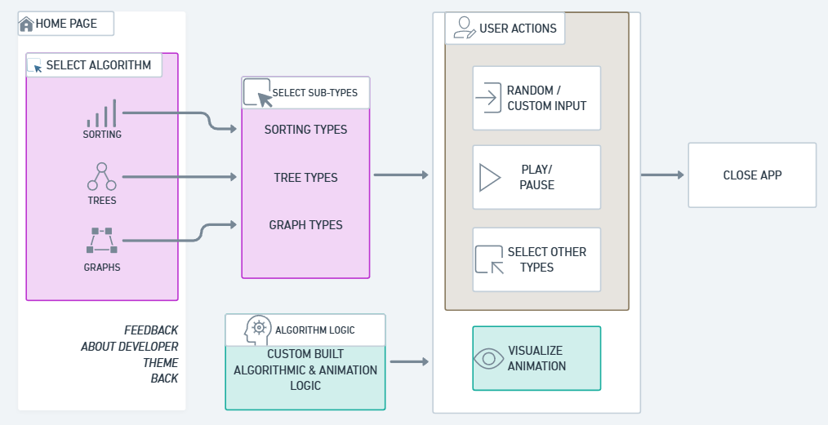
SYSTEM DESIGN
fig.1. proposed system design

Slide 11
TECHNOLOGY/TOOLS
Platform - Android Studio:
  Used as the integrated development environment (IDE) for building Android applications.
Language - Java:
  Primary programming language used to implement the application's logic.
Build Tool - Gradle:
  Automates building, testing, and packaging of the Android app

Slide 12
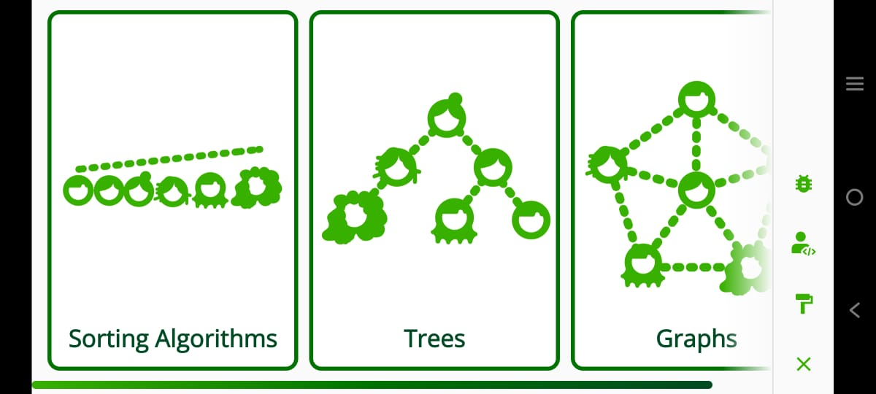
IMPLEMENTATION
Figure 1. Homepage

Slide 13
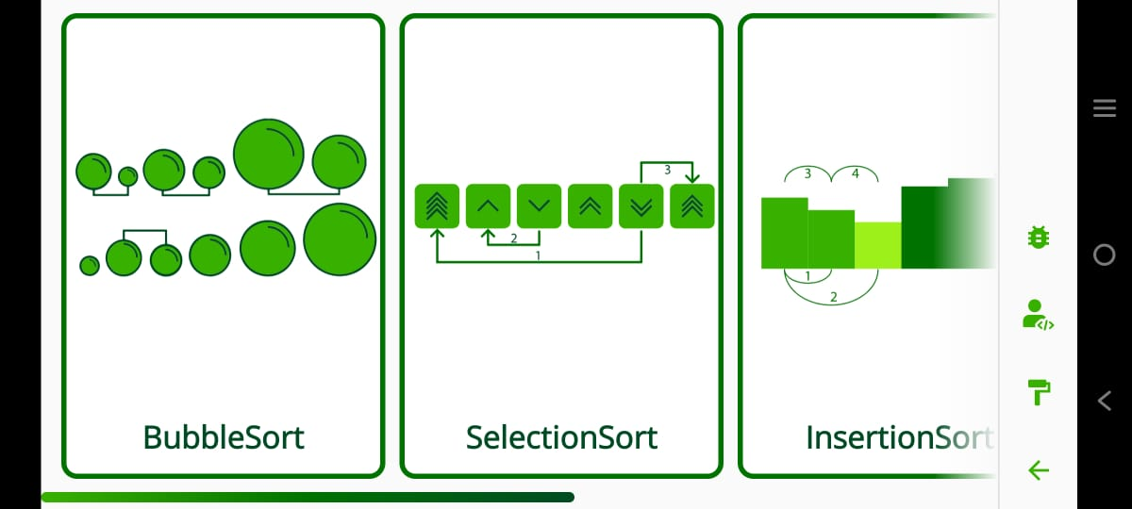
IMPLEMENTATION
Figure 2. Sorting Algorithms

Slide 14
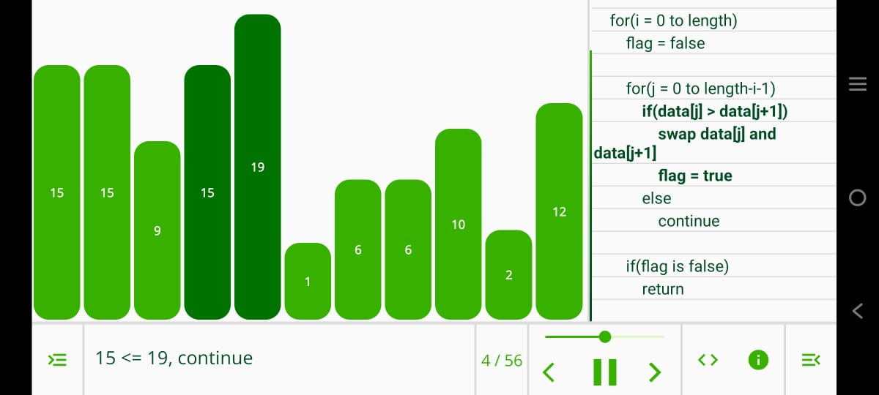
IMPLEMENTATION
Figure 3. Sorting Example
)

Slide 15
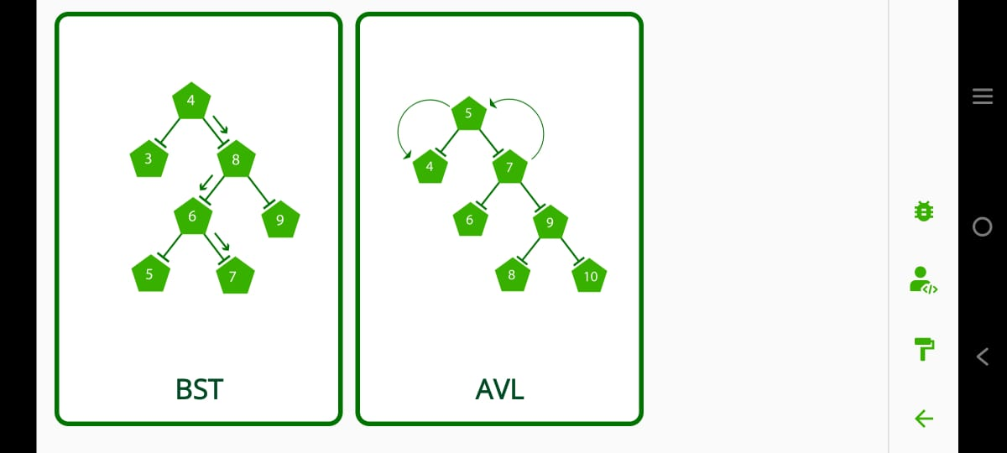
IMPLEMENTATION
Figure 4. Tree Algorithms

Slide 16
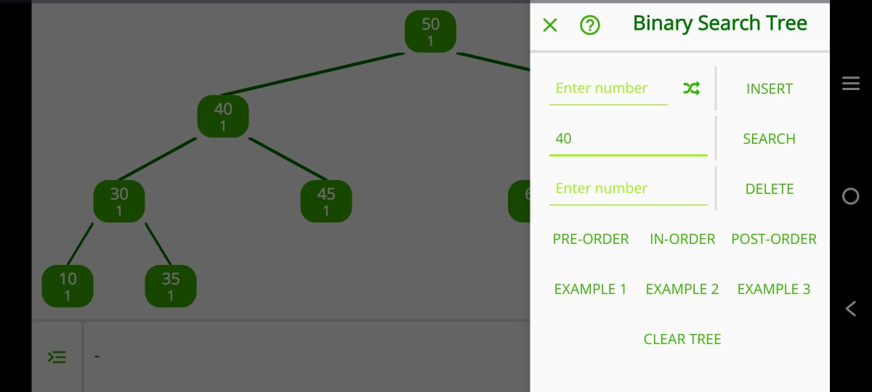
IMPLEMENTATION
Figure 5. Tree Example

Slide 17
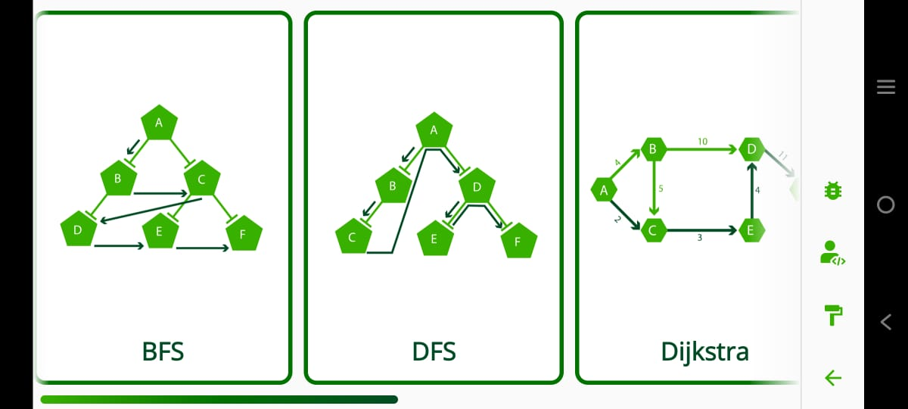
IMPLEMENTATION
Figure 6. Graph Algorithms

Slide 18
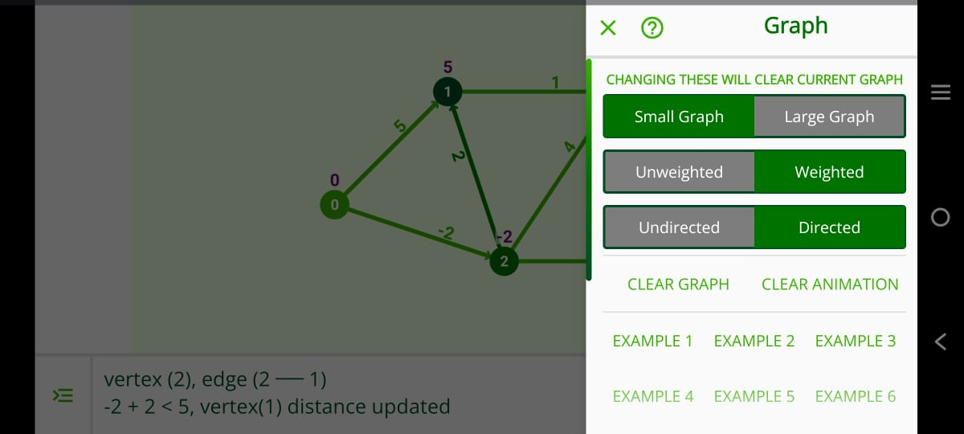
IMPLEMENTATION
Figure 7. Graph Example

Slide 19
CONCLUSION
Visualizes algorithms for better understanding
Makes DSA learning interactive and mobile-friendly
Supports self-paced, step-by-step learning
Scalable for more features and algorithms later

Slide 20
REFERENCES
[1] Kumari, A., Mittal, M., Jha, V., Sahu, A., Kumar, M., Sangwan, N., & Bohra, N. (2022). Algorithm visualisation—modern web-based visualization of sorting and searching algorithms. Advances and Applications in Mathematical Sciences, 21(9), 4441–4452.
[2] Lanjewar, R., Mehar, N., Doshi, A., & Mane, Y. (2022). AlgoVis—an enhanced way to visualise algorithms. In ITM Web of Conferences: International Conference on Advances in Computing and Communication (ICACC). EDP Sciences.
[3] Sharma, P., & Verma, K. (2024). The efficacy of animation and visualization in teaching data structures: A case study. Journal of Computer Science Education Research, 15(1), 55–68.
[4] Zhang, Y. (2024). Application of algorithm visualization techniques in teaching computer data structure course. International Journal of Education and Development using ICT, 20(2), 113–125.
[5] Bhandari, S. R., Abhijeet, C., Pratik, B., & Adinath, T. (2025). Algorithm visualization on data structures along with AI chatbot. International Journal of Innovative Research in Computer Science & Technology (IJIRCST), 13(1), 21–27.

Slide 21
THANK YOU...!!

